Slide 1
GEOG 392/676 GIS Programing Lab4
Zhenlei Song, Ph.D Student
Department of Geography
Email: songzl@tamu.edu
Office: CSA 301F

Slide 2
Lab 4 Tasks
Create GeoDatabase (GDB)
Add data from the provided “.csv” file
Buffer the garage points
Intersect the building with buffered points
Export the layers to a GDB

Slide 3
Reading Before Lab
ArcPy setup and basic operations
Setup
Basic Operations
ArcPy online documentation
ArcPy Docs

Slide 4
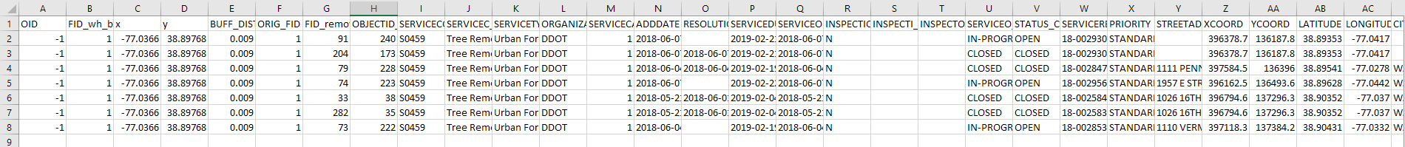
Preparation
Download “Lab4_data.zip” from Github: Link
Unzip “Lab4_data.zip”
Campus.gdb
Garages.csv

Slide 5
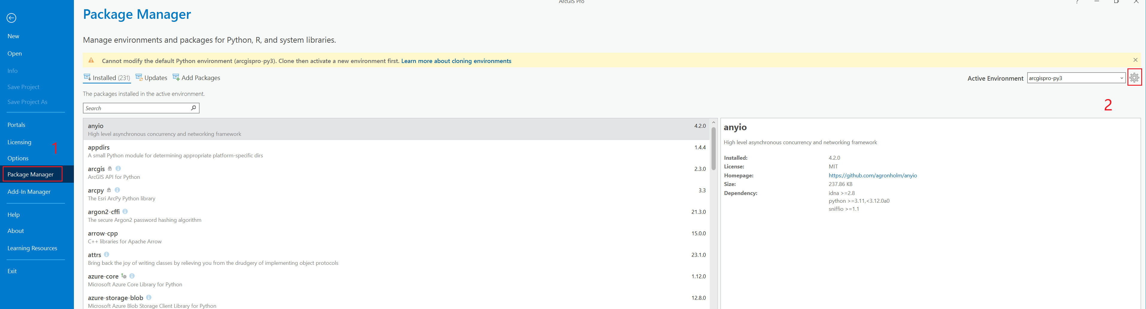
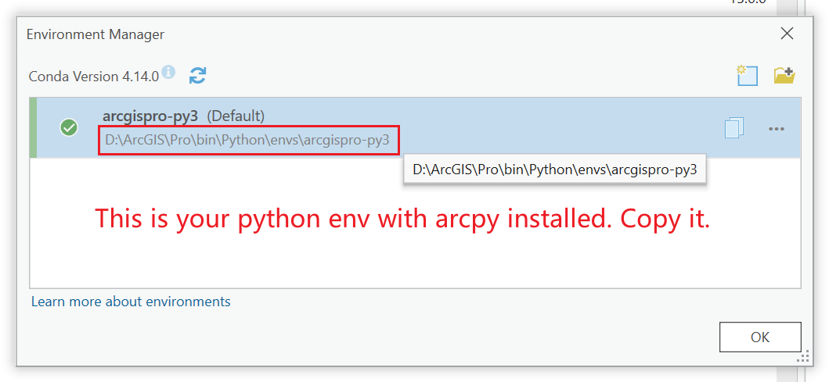
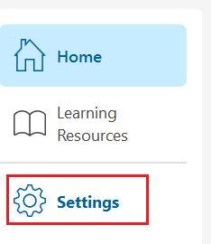
Preparation
Python in ArcGIS Pro

Slide 6
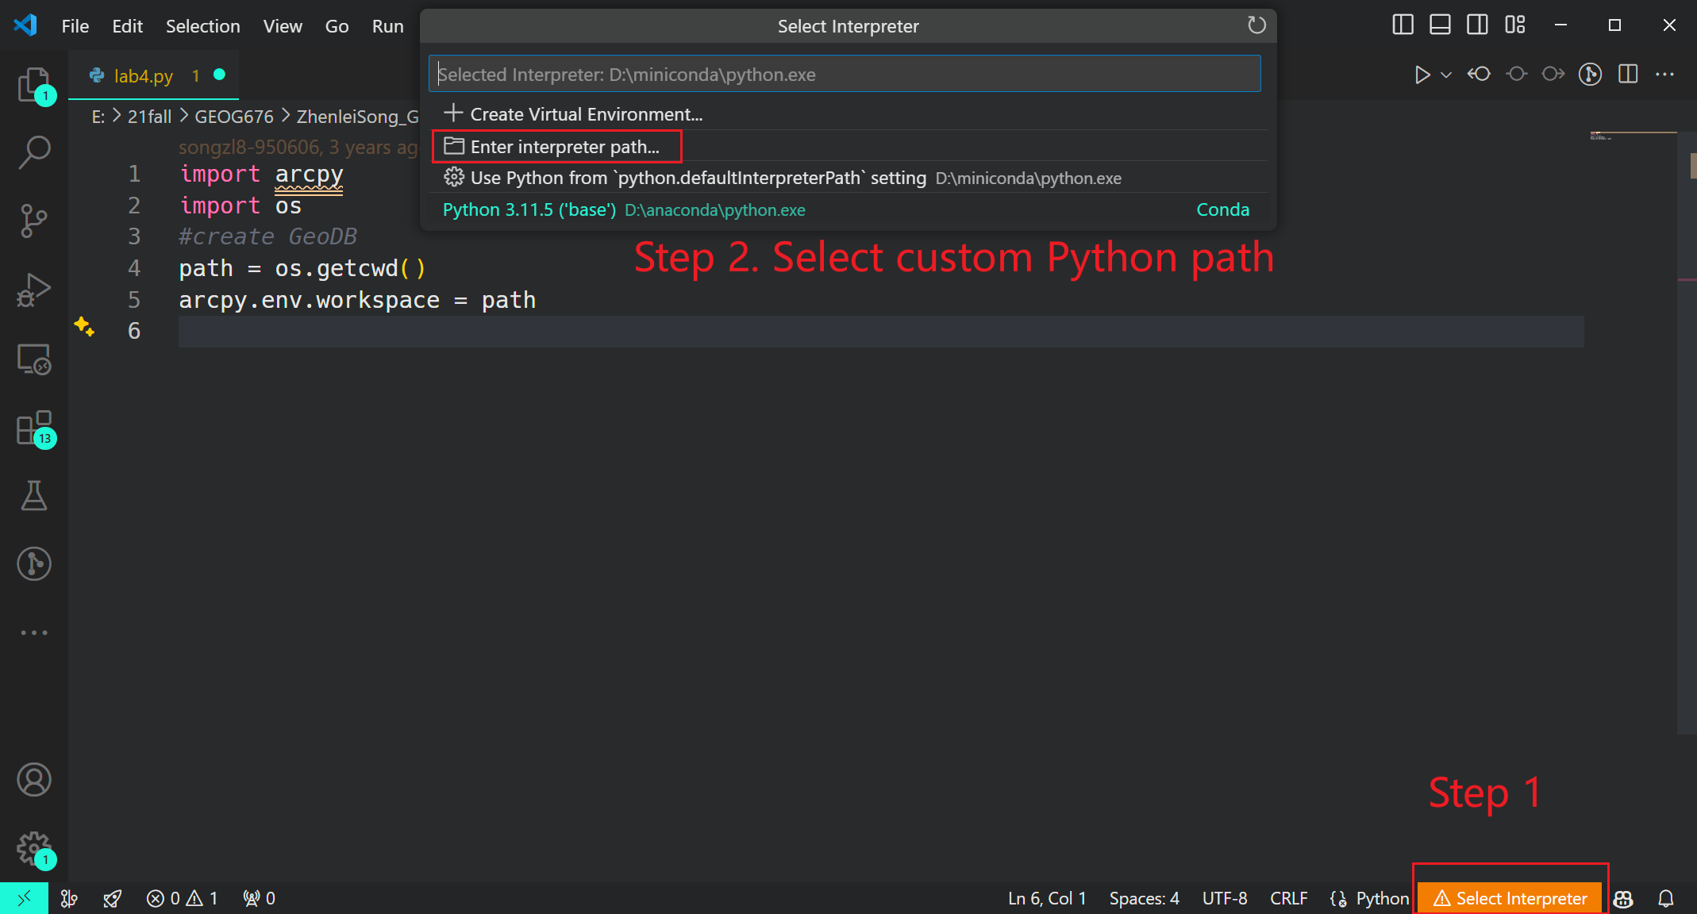
Preparation
Activate Python env in ArcGIS Pro

Slide 7
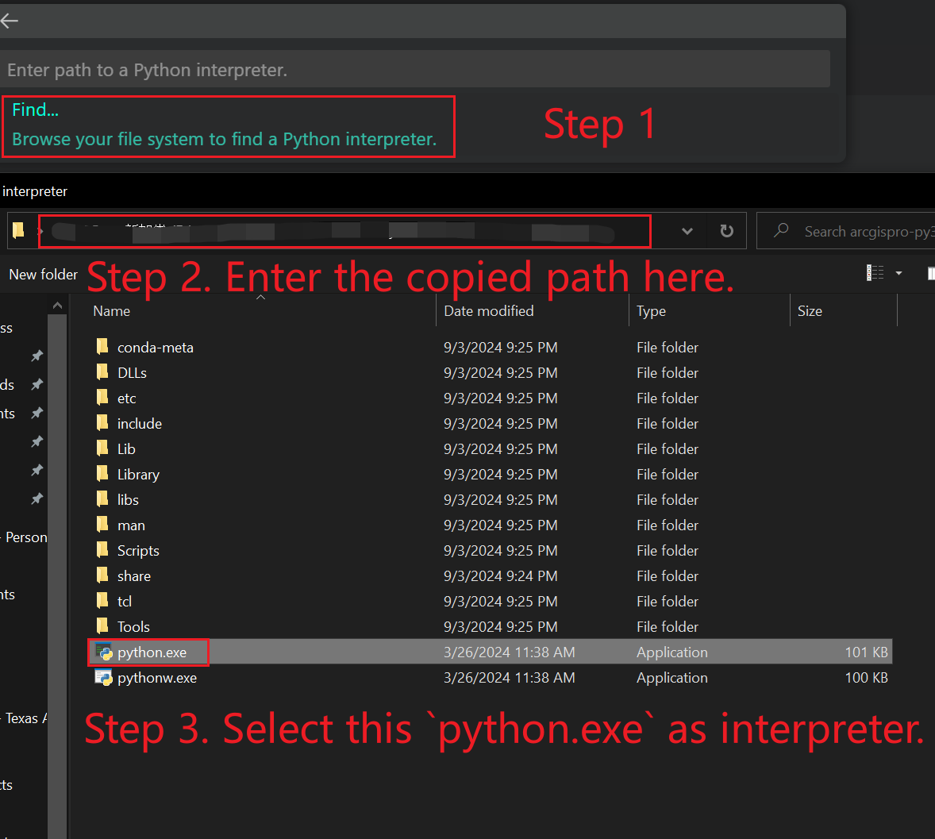
Preparation
Activate Python env in ArcGIS Pro

Slide 8
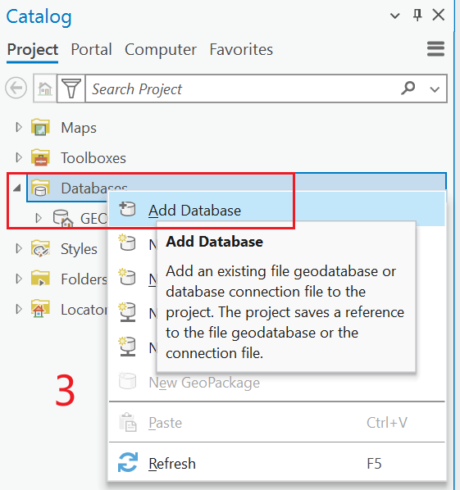
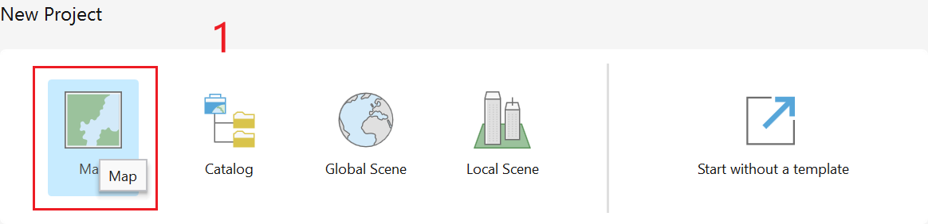
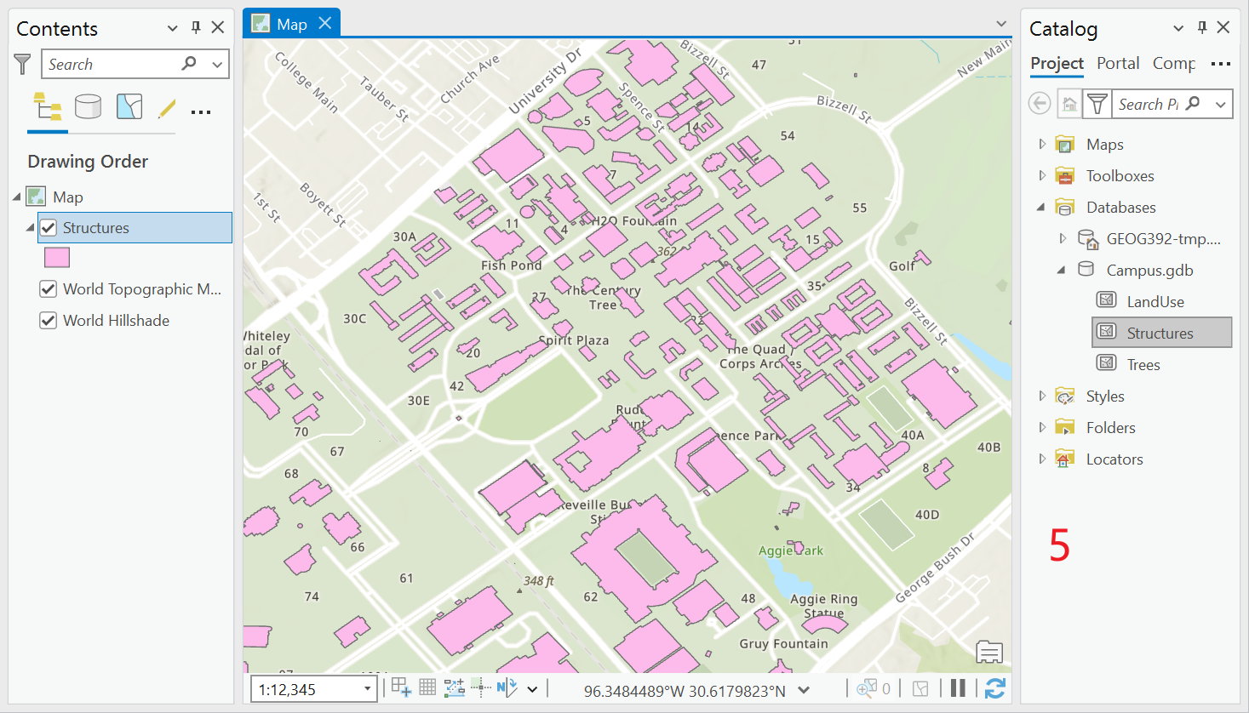
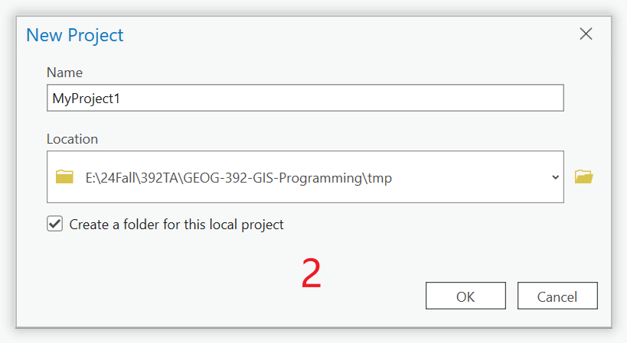
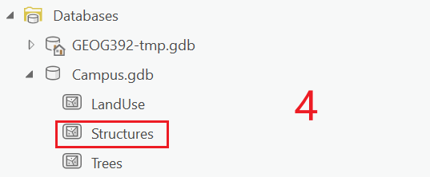
Data Source Preview

Slide 9
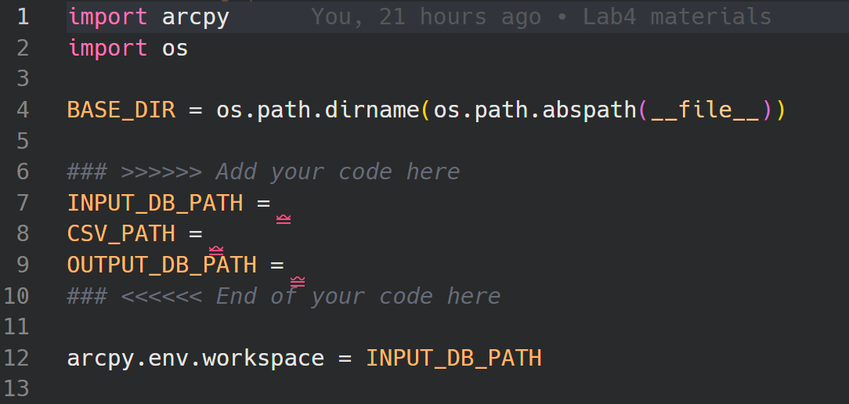
Set Base Working Path
Import libs
Set paths (optional)
Set the input GDB path as workspace path.

Slide 10
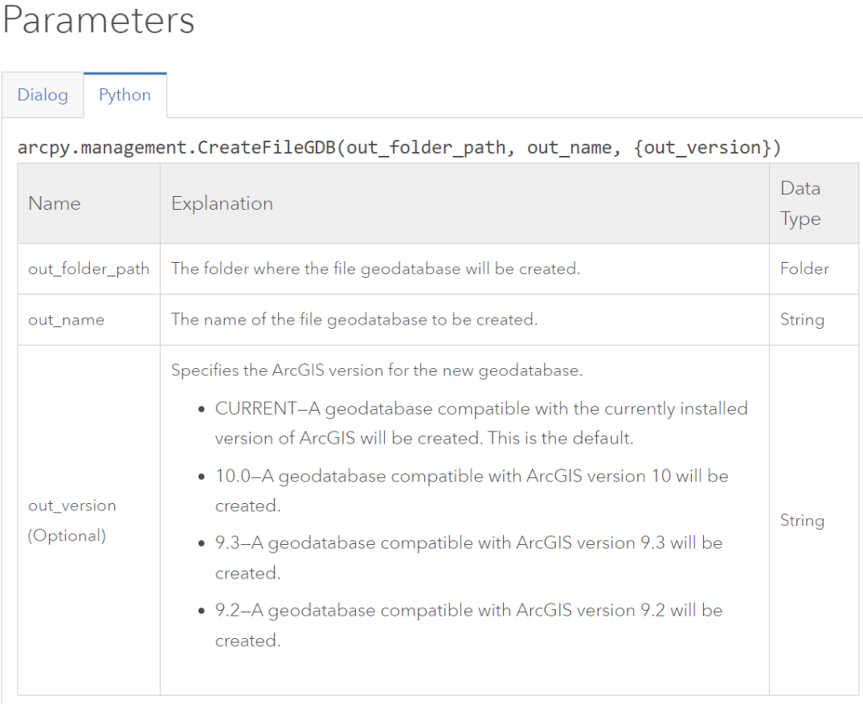
Create a new GDB
`arcpy.management.CreateFileGDB(para1, para2)`
or in older version
`arcpy.CreateFileGDB_management(para1, para2)
para1: the folder path where you want to save your GDB
para2: the name of your GDB
Help: http://pro.arcgis.com/en/pro-app/tool-reference/data-management/create-file-gdb.htm

Slide 11
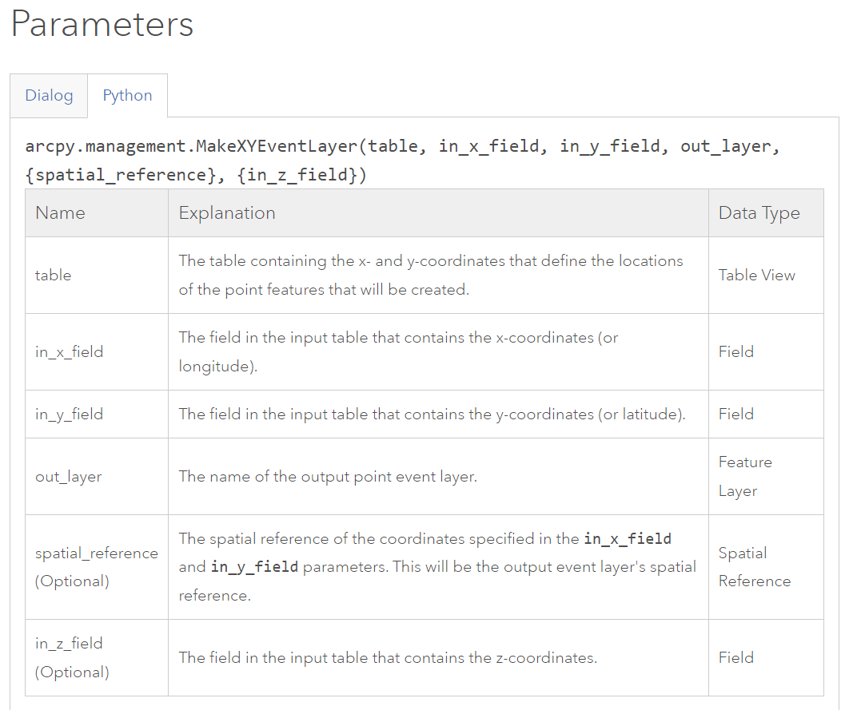
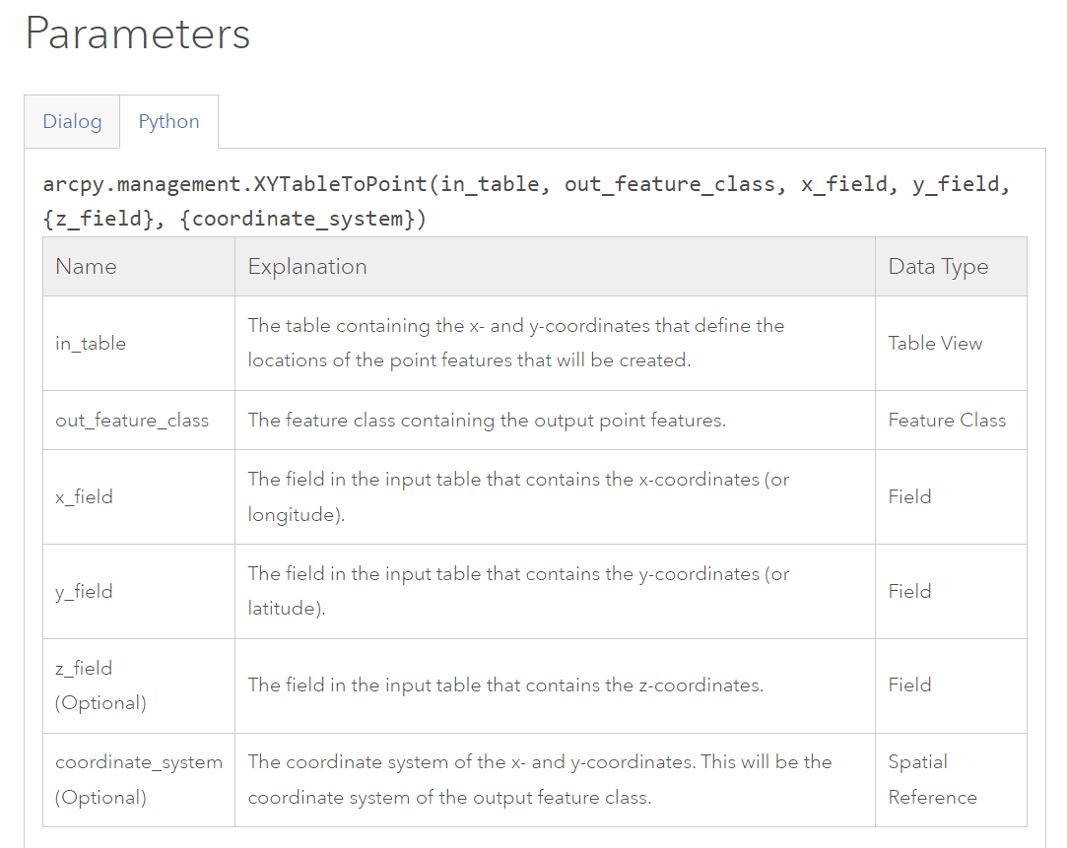
Import .csv file
arcpy.management.MakeXYEventLayer
Help
arcpy.management.XYTableToPoint
Help

Slide 12
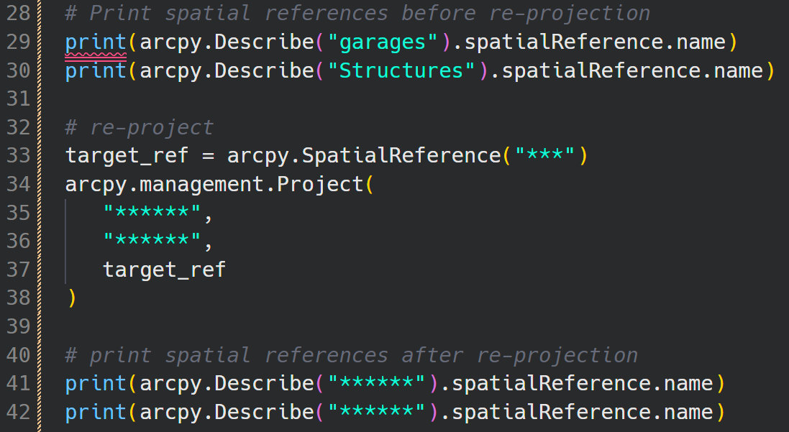
Re-Projectioin
Why? Bias between geographic coordinates systems
Help Links:
arcpy.Describe()
arcpy.SpatialReference
arcpy.management.Project()

Slide 13
Buffer, Intersect, Export
Buffer
arcpy.analysis.Buffer(para1, para2, para3)
Help
Para1: The input point, line, or polygon features that will be buffered.
Para2: The feature class containing the output buffers.
Para3: The distance around the input features that will be buffered.
Intersect
arcpy.analysis.Intersect(para1, para2, para3)
Help
Para1: A list of the input feature classes or layers.
Para2: The output feature class.
Para3: Specifies the attributes from the input features that will be transferred to the output feature class.
Export
arcpy.management.CopyFeatures(para1, para2)
Help
Para1: The features to be copied.
Para2: The feature class which will be created and to which the features will be copied.

Slide 14
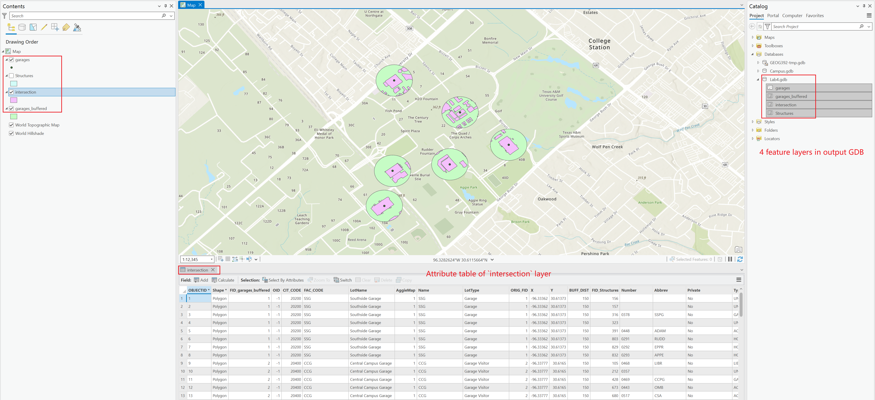
Results
Notes:
Export 4 feature classes (layers) to the GDB created at the beginning.
Load the GDB in ArcGIS Pro
Make sure it include layers:
Garages
Structures
Buffer
Intersect

Slide 15
Submission
Submit a PDF file includes:
Screenshots of all your codes
Screenshots of the running results (without error)
Screenshots of new GDB loaded in ArcGIS Pro
Link to your Github Repo
Grading Rules:
30 points for code running without errors.
30 points for correct shape of the intersection.
20 points for exporting to GDB.
10 points for the code quality and docstring.
10 points for Github repository.

Slide 16
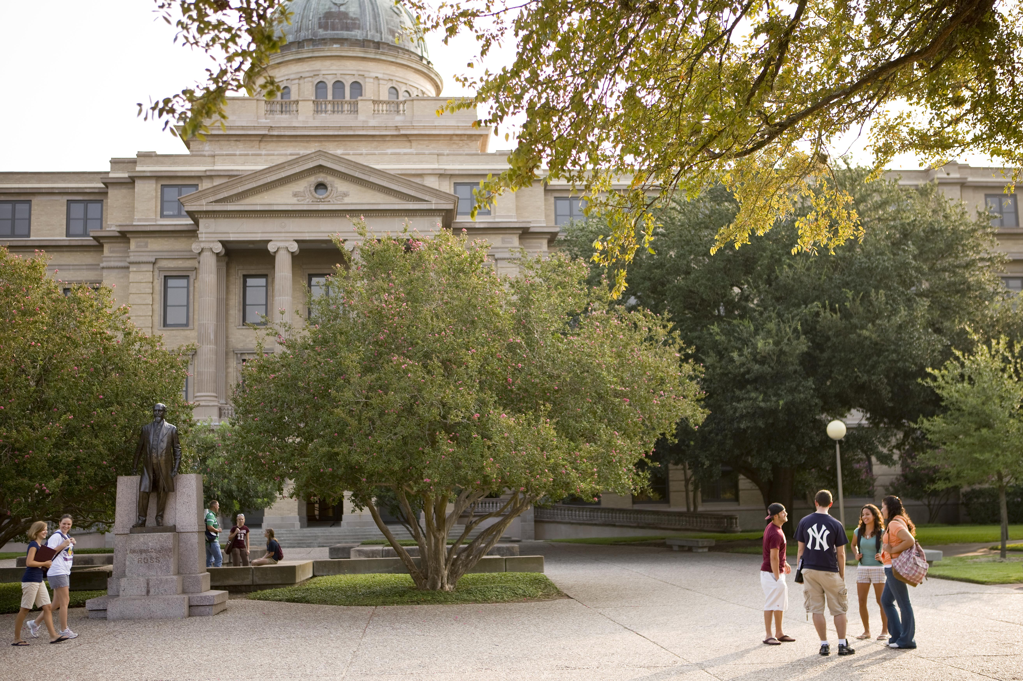
Additional Resources
Useful Links
ArcPy Documentation
Python in ArcGIS Pro
Available Python Libs in ArcGIS Pro
Debugging in VS Code
VS Code Plugins
Python
Pylance
Python Debugger
Gitlens

Slide 17
The End

